Slide 1
Distributed Systems

Slide 2
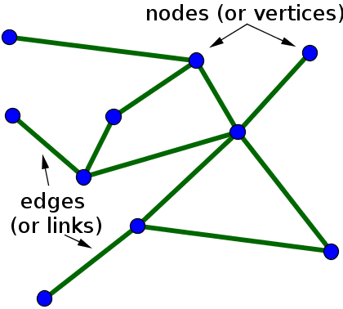
Distributed Systems
A distributed system is a system whose components are located on different networked computers, which communicate and coordinate their actions by passing messages to one another.
https://en.wikipedia.org/wiki/Distributed_computing

Slide 3
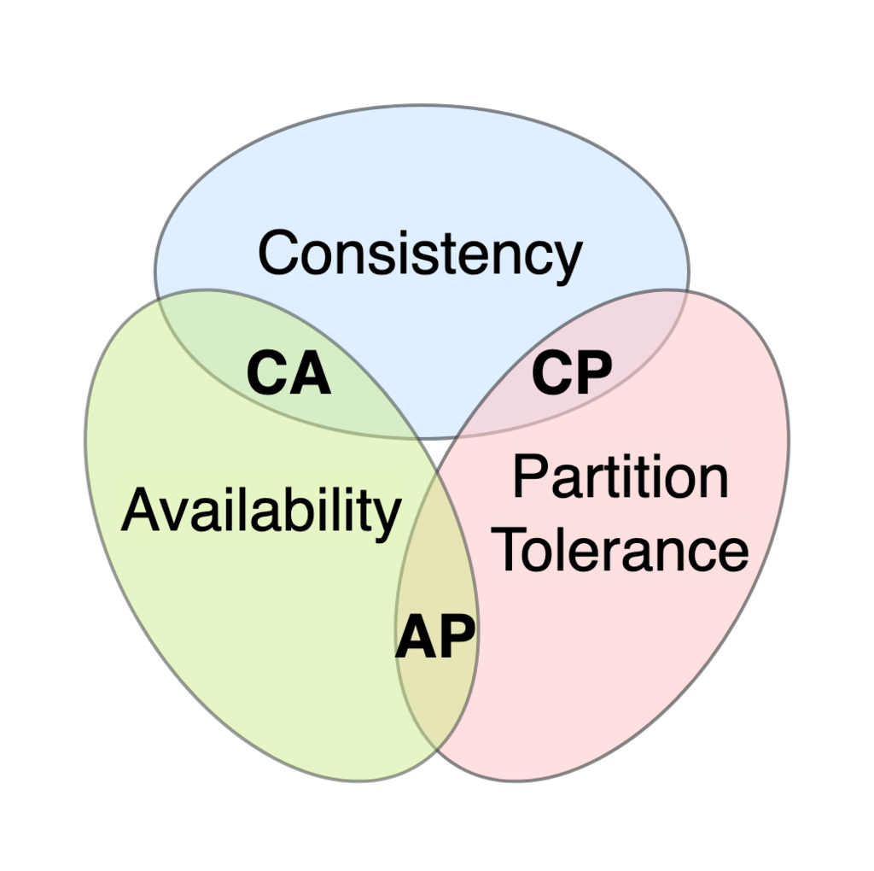
CAP theorem
Consistency: Every read receives the most recent write or an error.
Availability: Every request receives a (non-error) response, without the guarantee that it contains the most recent write.
Partition tolerance: The system continues to operate despite an arbitrary number of messages being dropped (or delayed) by the network between nodes
https://www.youtube.com/watch?v=BHqjEjzAicA

Slide 4
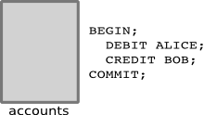
Transaction
https://es.wikipedia.org/wiki/Transacci%C3%B3n_(inform%C3%A1tica)

Slide 5
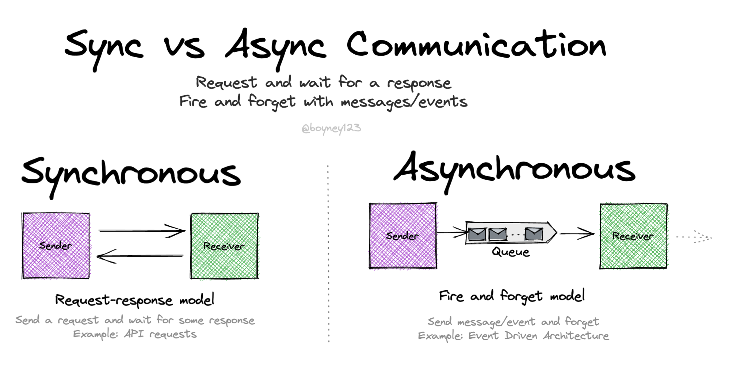
Communication
https://serverlessland.com/event-driven-architecture/visuals/sync-vs-async

Slide 6
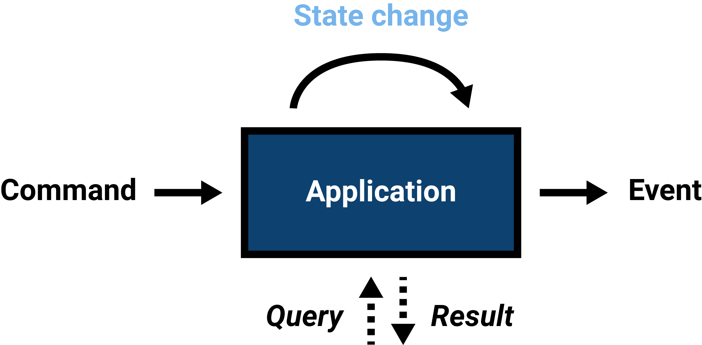
Message
https://www.arothuis.nl/posts/messaging-primitives/

Slide 7
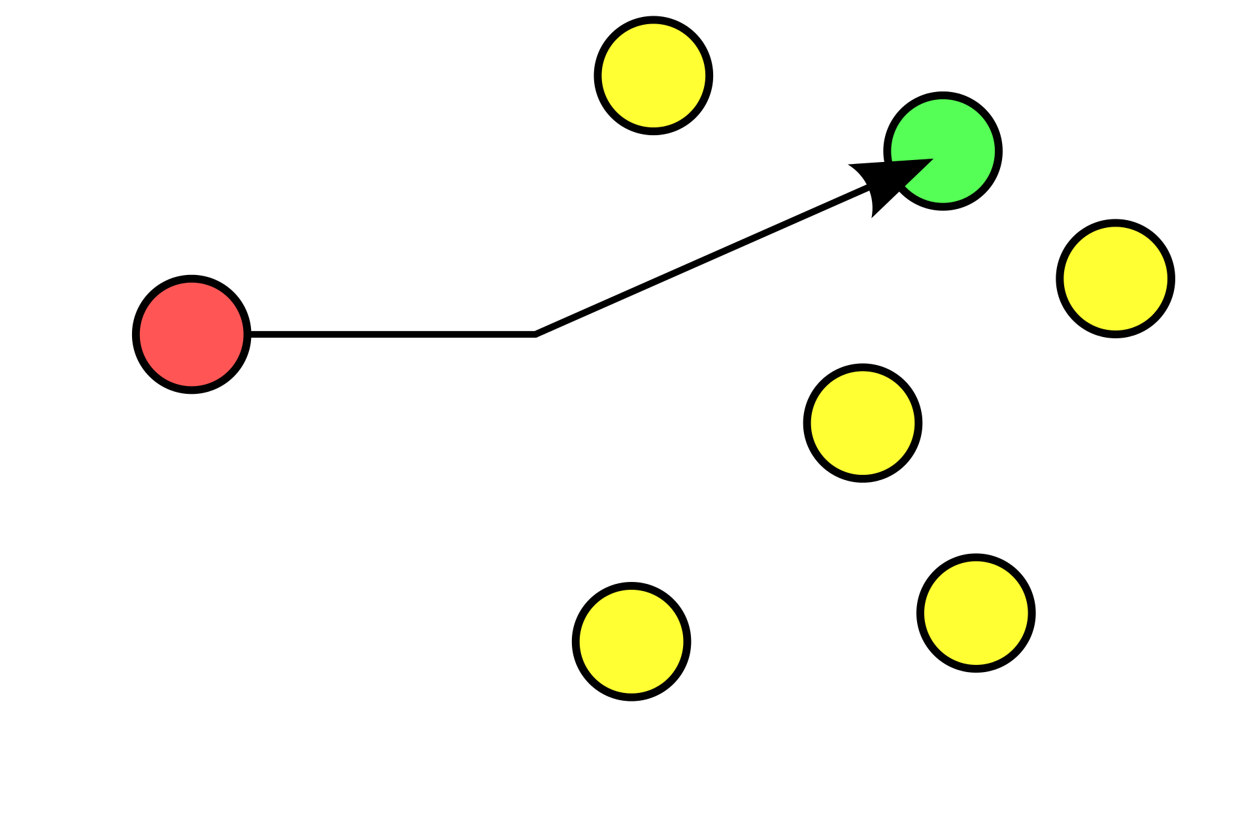
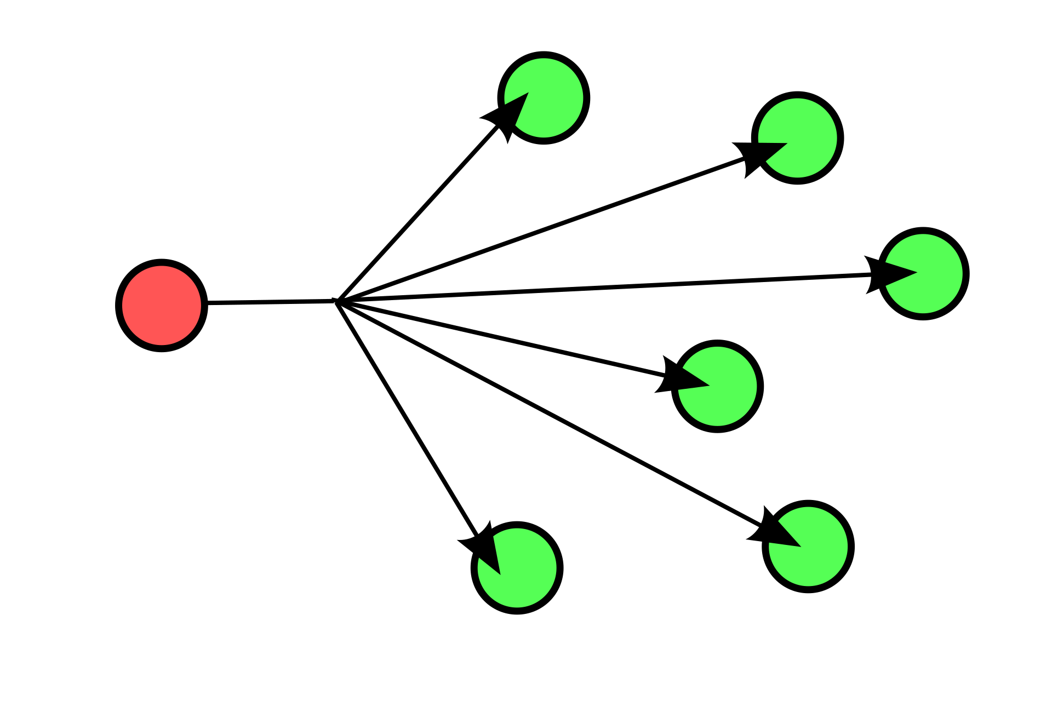
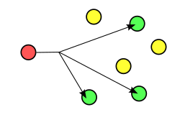
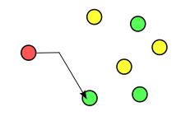
Routing schemes
Unicast
Broadcast
Multicast
Anycast
https://www.arothuis.nl/posts/messaging-primitives/

Slide 8
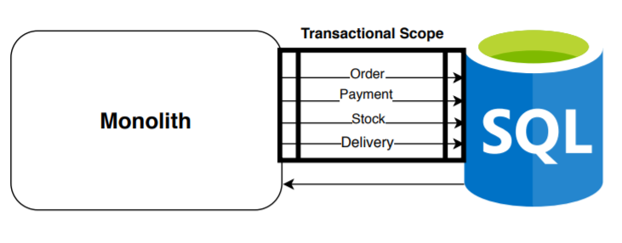
Monolith
https://josecuellar.net/data-consistency-the-problem-1-3/

Slide 9
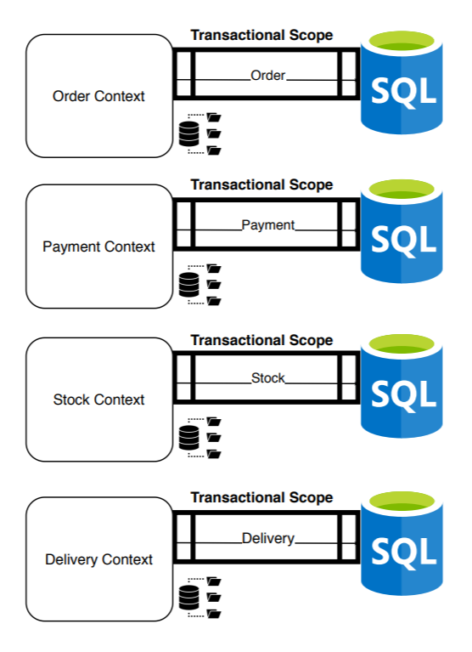
Microservices
https://josecuellar.net/data-consistency-the-problem-1-3/

Slide 10
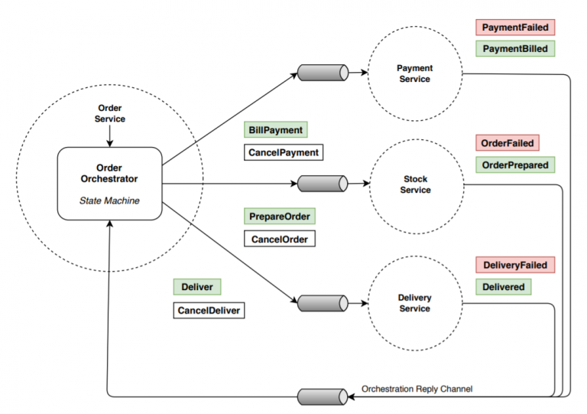
Orchestration
https://josecuellar.net/data-consistency-the-problem-1-3/

Slide 11
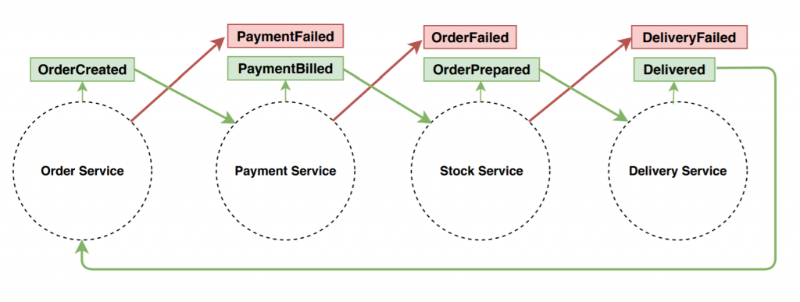
Choreography
https://josecuellar.net/data-consistency-the-problem-1-3/

Slide 12
Consistency models
Strong Consistency
Weak Consistency (Eventual Consistency)
https://mwhittaker.github.io/consistency_in_distributed_systems/

Slide 13
AWS
https://fourtheorem.com/what-do-you-need-to-know-about-sqs/
https://fourtheorem.com/what-can-you-do-with-eventbridge/
https://fourtheorem.com/what-do-you-need-to-know-about-sns/

